Slide 1


Implementing a Strategic Plan
Dialogue Guide
Board Training Series for Parent Centers
STRENGTHENING PARENT CENTER CAPACITY
Notes:
Slide #1: Welcome and Introduction
Procedural Directions:
What you will need for this module:
Laptop computer (equipped with PowerPoint software)
Speakers that are able to project the video sound adequately
Projector
Memory stick with the Implementing a Strategic Plan Dialogue Guide (PowerPoint) presentation & video (in case you can’t get on the internet)
White board or flip chart/easel, markers, paper, pens
Printed version of the Implementing a Strategic Plan Dialogue Guide speaker notes for your own use
Handout copies for participants (Implementing a Strategic Plan Dialogue Guide, 2/page; FAQ; Resource List, and Evaluation forms)
Handout copies for optional activities: (Indiana Nonprofit Resource Network); and Strategic Planning -Keeping Your Objectives SMART Mission-Focused Board Agenda Template
You may want to plan 25 – 45+ minutes on your Board agenda (video 8 minutes), Dialogue Guide (10+ minutes ), FAQ & Resource List (5 minutes), Evaluation (5 minutes).
Presenter Notes:
Hello and welcome to this professional development module on Implementing a Strategic Plan.
This is the third of three modules on Strategic Planning for Parent Centers. This module and the video associated with it addresses how to follow through once your Strategic Plan is developed.
We will first watch a short video that outlines this content.
Show the video: https://youtu.be/GfnBfHAcAgI
Show Slide #1. Let’s take a short time to discuss how the information from the video can be applied to our own organization.

Slide 2

Implementing a Strategic Plan
The Strategic Plan is a Tool for Staff and Board
Everyone in the organization should know the plan so that decisions & actions can be driven by a shared understanding of priorities and direction.
Notes:
Slide 2: The Strategic Plan is a Tool for Staff and Board
Procedural Directions:
Show slide # 2
Read the presenter notes.
Presenter Notes:
Your Board and staff will spend a good deal of time and energy to develop a Strategic Plan to guide your organization over the next several years. Congratulations! It’s time to put that plan to work, and to make sure it doesn’t become just another binder on the shelf or item checked off your to-do list.
The Strategic Plan can now go to work helping your staff and Board members make decisions, plan activities, and monitor progress.
The first step is making sure that the Plan is distributed, discussed, and owned by all who have a role in bringing it to life. This includes all Board members, your organization’s senior managers, and staff. It might also be shared with key stakeholders, such as constituents/families served and your funders.
Discussion: How can your Strategic Plan empower the Board to build community support and awareness of the organization?

Slide 3
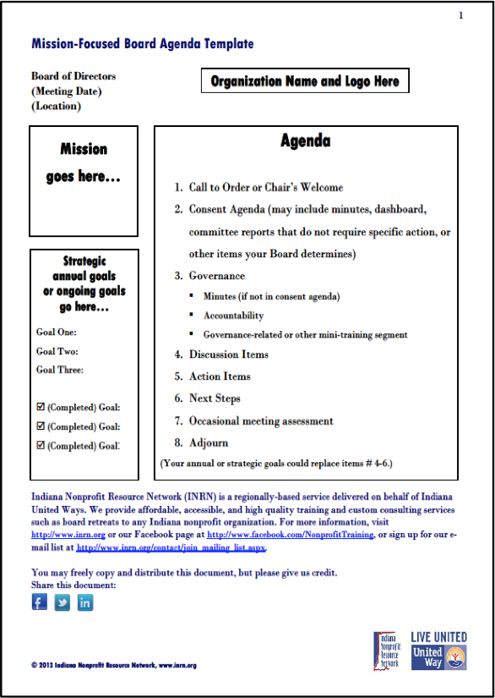
Implementing a Strategic Plan
Using the Strategic Plan in Board Meetings
Discussion items, action items, and next steps reflect the goals developed in the Strategic Plan
Notes:
Slide 3: Starting with Strategic Thinking
Procedural Directions:
Make sure participants have the following handout that will be used for this slide: Mission-Focused Board Agenda Template (The Indiana Nonprofit Resource Network)
Show slide #3
Read the presenter notes
Presenter Notes:
Your Strategic Plan can help make sure your Board maintains focus on the future and progress toward your goals. This Mission-Focused Board Agenda Template, developed by The Indiana Nonprofit Resource Network, is one example of how you can construct a Board meeting agenda that includes discussion of your progress on goals. Items 4, 5, and 6 on this agenda: discussion items, action items, and next steps, can align with strategic goals.
Discussion: How can you use your Strategic Plan to drive your Board agenda? What changes, if any, in your Board meeting agenda would help enable the Board to maintain a focus on strategic goals? How else can your Board use the Strategic plan in its’ work?

Slide 4

Implementing a Strategic Plan
Using the Strategic Plan for Staff Accountability
Communicate the Message
Align Objectives with the Plan
Set SMART Goals
Give feedback and adjust as needed
Notes:
Slide 4: Using the Strategic Plan for Accountability
Procedural Directions:
Show slide #4
Read the presenter notes.
Optional Activity – Have copies of Keeping Your Objectives SMART. At the end of this slide, if time permits, ask the participants to give examples of individual Board member or Committee SMART goals that align with the Strategic Plan.
Presenter Notes:
While the Board does not evaluate staff performance directly, it is important to understand how the Strategic Plan can enhance the performance of the organization when it is communicated clearly, and when the work of teams and individuals align with the plan.
When the Board evaluates the Executive Director, the Strategic Plan can provide clear criteria for determining whether the Executive Director is on-track and where mid-course corrections are needed.
Similarly, when working with the staff, the Executive Director and senior management team use the Strategic Plan to improve the management process and maximize the effectiveness of the members of individual teams. Managers help team members understand the individual roles they play and how their jobs contribute to success. The Strategic Plan can help all staff assess and prioritize efforts and be sure that work is focused on what is important.
The "Activity Trap" is when we get so busy doing things that we forget to ask whether what we're doing are the right things. The Strategic Plan can help avoid this trap.
The S.M.A.R.T. method is one way to put the Strategic plan into action. This is relevant for staff, but also for the Board in planning its work.:
Specific (and strategic): Linked to position, team goals/mission, and strategic plan. Answers the question—Who? and What?
Measurable: The success toward meeting the goal can be measured. Answers the question—How?
Attainable: Goals are realistic and can be achieved in a specific amount of time and are reasonable.
Relevant (results oriented): The goals are aligned with strategic objectives and focus in one defined area; include the expected result.
Time framed: Goals have a clearly defined time-frame including a target or deadline date.
Here are some examples of SMART Goals:
"The Education department will develop a new half-hour outreach presentation on school discipline, including a written trainer’s guide, by August 2018.“
"The Board Fundraising Committee will develop a system of tiered giving circles for major donors, and create a written brochure describing the giving circles by December 2018."
"The volunteer coordinator will recruit and train 20 new volunteer advocates s by conducting outreach at a minimum of five community events and offering two mentor trainings in April and September of 2018.”
Optional Activity:
Use HO “Strategic Planning -Keeping Your Objectives SMART” to generate possible objectives for your organization’s Strategic Plan.

Slide 5

Development Team:
David Blanchard, Region 3 PTAC, at P2P of GA
Glenda Hicks, Glenda Y. Hicks, CPA
Rachel Howard, Rachel Howard Consulting
Jan Serak, Region 4 PTAC, at WI FACETS
Other Contributors:
Debra Jennings, CPIR, at SPAN
Diana Autin & Carolyn Hayer, NE-PACT/Region 1 PTAC, at SPAN
Connie Hawkins, Rene Averitt-Sanzone, Laura Weber, Region 2 PTAC, at ECAC
Debi Tucker, Stephanie Moss, Region 3 PTAC, at P2P of GA
Courtney Salzer, Region 4 PTAC, at WI FACETS
Barb Buswell, Emily Rome, Jacey Tramutt, Region 5 PTAC, at PEAK
Nora Thompson, Region 6 PTAC, at Matrix
The contents of this product were developed under a grant to WI FACETS from the U.S. Dept. of Education, #H328R130010. The contents do not necessarily represent the policy of the U.S. Dept. of Education and you should not assume endorsement by the federal government.
Project Officer: David Emenheiser.
© RPTACs. For permission to use, please contact WI FACETS.
Notes:
Slide #5: Wrap Up & Module Credits
Procedural Directions:
Hand out the FAQ, Resource List, and Evaluation for this part.
If time permits, you can review the FAQ. You can also select 1-2 resources from the Resource List that speak to you and provide copies of them for additional discussion.
Show slide #5.
Read Presenter Notes
Presenter Notes:
You have in the materials for this module an FAQ sheet and a Resource list. These are intended as a “take home” for you of key points and important supplementary materials to review at your leisure.
The materials for these modules were developed by a Development Team and by the 6 Regional Parent TA Centers and the National Center for Parent Information and Referral. There are 6 Tool Kits with 18 videos available for Boards.
Please complete the evaluation form. The developers are very interested in your evaluation of these resources.

