Slide 1

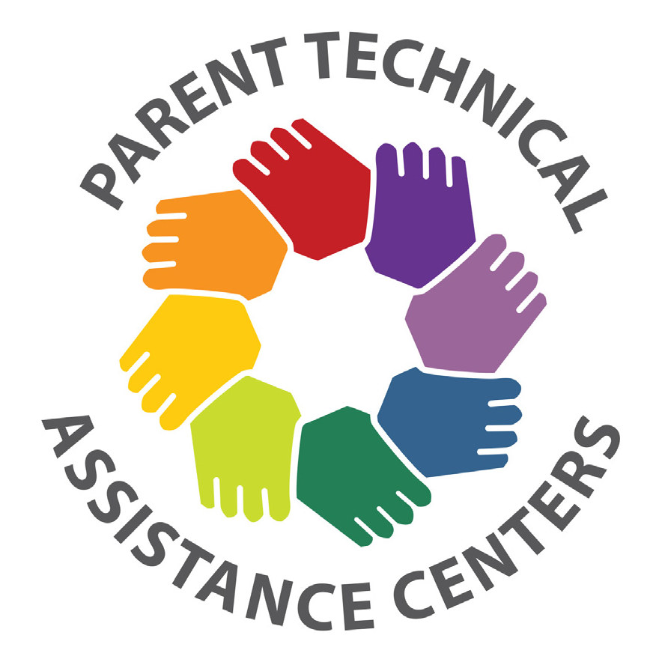
Why Strategic Planning Is Important
Dialogue Guide
Board Training Series for Parent Centers
STRENGTHENING PARENT CENTER CAPACITY
Notes:
Slide #1: Welcome and Introduction
Procedural Directions:
What you will need for this module:
Laptop computer (equipped with PowerPoint software)
Speakers that are able to project the video sound adequately
Projector
Memory stick with the Why Strategic Planning is Important Dialogue Guide (PowerPoint) presentation & video (in case you can’t get on the internet)
White board or flip chart/easel, markers, paper, pens
Printed version of the Why Strategic Planning is Important Dialogue Guide speaker notes for your own use
Handout copies of select handouts for participants (Why Strategic Planning is Important Dialogue Guide 2/page; the Mission-Focused Board Agenda, FAQ; Resource List, Evaluation forms)
Handout copy of your organization’s Strategic Plan if you have one.
Plan 30-45+ minutes on your Board agenda (video 10:48 minutes, Dialogue Guide 10 - 15 minutes), FAQ & Resource List (5 minutes), complete Evaluation form (5 minutes)
Presenter Notes:
Hello and welcome to this professional development module on Why Strategic Planning Is Important.
This is the first of three modules on Strategic Planning for Parent Centers. The following two modules on this topic are How to Develop a Strategic Plan, and Implementing the Strategic Plan. The purpose of this module is to introduce and define strategic planning and outline its benefits.
We will first watch a short video that outlines this content.
Show the video: https://youtu.be/pzUcUvt0zE0
Show Slide #1. Let’s take a short time to discuss how the information from the video can be applied to our own organization.

Slide 2
Why Strategic Planning Is Important
Context: The Board’s 3 Primary Responsibilities
SET DIRECTION
Ensure Resources
Provide Oversight
Notes:
Slide 2: Context: The Board’s Three Primary Responsibilities
Procedural Directions:
Show slide # 2
Read the presenter notes.
Presenter Notes:
Throughout this Board Tool Kit series, we have talked about the three primary responsibilities of Boards: setting direction, ensuring resources, and proving oversight.
Strategic planning corresponds with the first responsibility, setting direction. It is a fundamental responsibility for Parent Center Boards.
It is an opportunity to reassess or reconfirm the mission of the organization, which may have “drifted” due to changes in funding or need.
It’s a framework for making decisions about programs, services, and resources.
It allows us to think about how our world is changing, and how we can operate most effectively in that changing world.
It enables the Board to take a big picture view of the organization and set a roadmap for the future.
For Parent Center Boards, this process usually includes participation of management and staff as well as the Board.

Slide 3
Why Strategic Planning Is Important
What is a strategic plan?
A strategic plan tells you:
where you are going (goals),
how you will get there (activities),
when you know you have accomplished goal (metrics),
who will lead the efforts (responsible parties).
Notes:
Slide 3: What is a strategic plan?
Procedural Directions:
Show slide #3
Read the presenter notes
Handout copy of your organization’s Strategic Plan if you have one.
Presenter Notes:
A strategic plan is like a map. It tells you where you are going (goals), how you will get there (activities), when you know you have accomplished goal (metrics), and who will lead the efforts (responsible parties).
Lots of people think that developing a plan is daunting, and may worry that it might take too long, use too many resources, or bog down the Board. This does not need to be the case. The other modules in this Tool Kit, “How to Prepare a Strategic Plan” and “Implementing a Strategic Plan”, will help you approach strategic planning in a in a straightforward way that fits your organization’s needs and circumstances.
Your annual OSEP Parent Center’s grant deliverables are not your Strategic Plan, although the grant goals should be considered to see how they may fit into your planning. A Strategic Plan usually has a 3 – 5 year horizon. A Strategic Plan will help you develop your organization’s annual goals and objectives. And it has the benefit of tying those shorter term objectives to a longer term vision of the work you plan and the resources, processes, and structure needed to get there.
Engage participants in the following discussion:
When did your organization last develop a strategic plan?
What was most helpful/beneficial about the process?
What were the challenges?
Optional Activity:
Use your organization’s Strategic Plan for the discussion above.

Slide 4
Why Strategic Planning Is Important
Benefits of Planning
Strategic planning is a “mission critical” component to sustainability
Notes:
Slide 4: Benefits of Planning
Procedural Directions:
Show slide #4
Read the presenter notes.
Presenter Notes:
Whether you want to grow, or to stay the size you are and provide services that are as effective as possible, a Strategic Plan will help.
A Strategic Plan enables the Board to look at the big picture rather than getting bogged down in the day-to-day, anticipating proactively what will be needed down the road. It helps the Board consider policy and funding changes, changing community needs and resources, understand the potential for collaborations, and anticipate the need for infrastructure like space or equipment, or build staff capacity and new skills.
A Strategic Plan helps you stay on course. It helps you keep your focus, and guides when you can – and should – say “no” to opportunities or activities that do not further your mission.
A Strategic Plan is often requested by foundations and other funders.
If the need you first served changes from when your organization was founded, then the Strategic Planning process enables you to reexamine your mission.
A Strategic Plan helps you develop your annual operating plan and provides the basis of the evaluation of the Executive Director. It can be used for setting the organization’s goals and for reporting to the Board. See the sample Board agenda distributed to all.

Slide 5

Development Team:
David Blanchard, Region 3 PTAC, at P2P of GA
Glenda Hicks, Glenda Y. Hicks, CPA
Rachel Howard, Rachel Howard Consulting
Jan Serak, Region 4 PTAC, at WI FACETS
Other Contributors:
Debra Jennings, CPIR, at SPAN
Diana Autin & Carolyn Hayer, NE-PACT/Region 1 PTAC, at SPAN
Connie Hawkins, Rene Averitt-Sanzone, Laura Weber, Region 2 PTAC, at ECAC
Debi Tucker, Stephanie Moss, Region 3 PTAC, at P2P of GA
Courtney Salzer, Region 4 PTAC, at WI FACETS
Barb Buswell, Emily Rome, Jacey Tramutt, Region 5 PTAC, at PEAK
Nora Thompson, Region 6 PTAC, at Matrix
The contents of this product were developed under a grant to WI FACETS from the U.S. Dept. of Education, #H328R130010. The contents do not necessarily represent the policy of the U.S. Dept. of Education and you should not assume endorsement by the federal government.
Project Officer: David Emenheiser.
© RPTACs. For permission to use, please contact WI FACETS.
Notes:
Slide #5: Wrap Up & Module Credits
Procedural Directions:
Handout the FAQ, Resource List, and Evaluation for this part.
If time permits, you can review the FAQ. You can also select 1-2 resources from the Resource List that speak to you and provide copies of them for additional discussion.
Show slide #5.
Read Presenter Notes
Presenter Notes:
You have in the materials for this module an FAQ sheet and a Resource list. These are intended as a “take home” for you of key points and important supplementary materials to review at your leisure.
The materials for these modules were developed by a Development Team and by the 6 Regional Parent TA Centers and the National Center for Parent Information and Referral. There are 6 Tool Kits with 18 videos available for Boards.
Please complete the evaluation form. The developers are very interested in your evaluation of these resources.

