Slide 1
Is It Lobbying? Is It Not?
Presented by Diana Autin, Director
National Center for Parent Leadership, Advocacy & Community Empowerment (National PLACE)
Ensuring a place at the table for every family!
Notes:
Shi

Slide 2
Who is National PLACE?
We are a national non-profit organization committed to helping family-led organizations and individual families acquire the knowledge and skills needed to effectively “sit at the table” and influence the policies and decisions that impact the lives of children, youth, and families, including families that face the greatest challenges due to disability, special healthcare needs, poverty, and discrimination
We are a coalition of non-profit family driven organizations
Currently 75 national, state, & local family-led, family-serving organizational members including Parent Centers, F2Fs, Parent to Parent Programs, & Federation of Families for Children’s Mental Health Affiliates

Slide 3
TOPICS FOR TODAY
What is lobbying?
Grassroots lobbying
Direct lobbying
Can non-profits lobby?
Should you elect the 501(h) expenditure test?
How can you influence policy without lobbying?
What are legislative scorecards?
Registration & reporting
Penalties/sanctions
Sample policy

Slide 4
What issues do you care about?

Slide 5
What is lobbying?
Direct lobbying =
Communication
With a legislator (or your members)
Expressing a view about specific legislation (or asking your members to be in touch with legislators)
Grassroots lobbying=
Communication
With the public
Expressing a view about specific legislation
Including a call to action

Slide 6
Communication
A conversation in person or on the phone, letter, email, fax or other creative mechanism to convey a message

Slide 7
Legislator
A member of a legislative body (City Council, State Legislature, U.S. Congress) & staff
Executives when vetoing or signing a bill
NOT an administrative body (regulations are not legislation!)

Slide 8
The Public
Communication to the public (anyone who is not a legislator or a member of the organization) = grassroots lobbying
Communication to members (has given > small amount of time or money) = direct lobbying

Slide 9
Expressing a view about legislation
Legislation = a bill or resolution introduced in a legislative body or proposed legislation
Includes budget appropriations & taxes & attempts to influence the confirmation of judicial & executive branch nominees
Does NOT include regulations, executive orders, litigation, or enforcement of existing legislation
Does NOT include calls for adequate funding if there is no budget proposal before the legislature
Notes:
Specific legislation includes a specific measure that has not yet been introduced, such as funding for the F2Fs or Parent centers, as well as legislation that has been introduced, such as legislation to block grant Medicaid, but does not include general concepts for solving problems that have not been reduced to legislative proposals.

Slide 10
Call to action
Encouraging the communication’s recipient to take lobbying action
Tell to contact legislator
Provide info on how to contact legislator
Provide way to contact legislator
Identify a legislator as being opposed to or undecided about the organization’s view on the legislation, a member of a legislative committee, or recipient’s legislator
Notes:
To be a grassroots lobbying communication, subject to the 25% ceiling, a communication must refer to specific legislation, reflect a view on it, and encourage recipients to contact legislators. Such a call to action exists only when the material directly tells its audience to contact legislators, provides a legislator’s address, phone number, or similar information; provides a petition, postcard, or other prepared message to be sent to the legislator; or identifies one or more legislators as opposing your views, being undecided, being the recipients’ representative(s), or being a member of the committee that will consider the legislation. A nonprofit may make any public statement it likes about a legislative issue without having the costs counted against its grassroots lobbying limit as long as it avoids calls to action. The following example was given by the IRS as being NOT grassroots lobbying: “The State Assembly is considering a bill to make gun ownership illegal. This outrageous legislation would violate your constitutional rights and the rights of other law abiding citizens. IF this legislation is passed, you and your family will be criminals if you want to exercise your right to protect yourselves.” Because there is no specific call to action, this is not grassroots lobbying. However, it would be grassroots lobbying if it was mass media advertising just before a vote on legislation that has elicited a high degree of public awareness: The legislation must have received so much publicity that its pendency, general terms, or effect are known to a significant element of the general public and not just to the particular interest groups directly affected; the nonprofit has bought paid advertising in the mass media; the advertising appears within two weeks before a vote will be taken in the full house or full committee (not subcommittee); and the ad either refers directly to the legislation even if it doesn’t contain a call to action, or the ad states a view on the general subject and urges the public to communicate with legislators about that subject.

Slide 11
Ballot measures
Ballot measure activity = direct lobbying, not impermissible electoral activity
The voting public = the legislature in a ballot measure (referenda, bond measures, ballot initiatives)

Slide 12
When does it become lobbying?
Preparation & research time in anticipation of lobbying
Discussing public issues, formulating & agreeing upon positions, & studying them in preparation of adopting a position for lobbying
You begin measuring lobbying activity when the primary purpose of your preparation or research is to engage in lobbying activity
Notes:
However, if research was not conducted or materials were not developed for the purpose of lobbying, then the cost of the research or material development is not counted as lobbying even if it is later used for lobbying as long as the lobbying use occurs more than six months after the research project or material development is completed.

Slide 13
Measuring Lobbying Activities
The 501(h) expenditure test
All costs including photocopying, transportation, staff time, overhead costs aimed at lobbying
The Insubstantial part test
No guidance on how much is “substantial”

Slide 14
“Insubstantial part”
Can lobby as long as the lobbying activities do not become a “substantial part” of its overall activities
Subjective test based on circumstances & facts of each case
Reimbursements to volunteers for out-of-pocket expenses spent on lobbying counts & must be reported

Slide 15
“Insubstantial part”
Factors include:
Absolute amount spent
Impact
Public prominence
Unpaid volunteer work

Slide 16
501(h) Expenditure test
Only counts lobbying activity that costs $
Limits vary on size of organization budget
$500,000 or less = 20%
$500,000-$1 million = $100,000 + 15% of budget over $500,000
$1-1.5 million = $175,000 + 10% of budget > $1 million
$1.5 million + > = $224,000 + 5% of budget > $1.5 million
Maximum $1 million/year
May spend up to ¼ of overall budget on grassroots lobbying
Notes:
The only factor that is taken into account is the cost of communications for direct or grassroots lobbying including the cost of preparing the communication (such as staff time, facilities, allocable overhead). To be a direct lobbying communication, and therefore to count against the direct lobbying limits, a communication must refer to specific legislation and reflect a point of view on its merits.

Slide 17
501(h) Expenditure Test
May develop & disseminate a “nonpartisan analysis, study or research” or a substantive report that fully discusses the pros and cons of a legislative proposal without it being considered lobbying

Slide 18
Making the 501(h) Election
Board votes to elect
Complete Form 5768
Make a copy
Mail to IRS
Track lobbying expenditures
Direct lobbying = 20% of 1st $500,000 + 15% of next $500,000 + 10% of next $500,000 + 5% of remainder
< 25% of overall lobbying limit can be spent on grassroots lobbying

Slide 19
Advocacy that is not lobbying
Nonpartisan analysis or research
Communication to members on legislation without a call to action
Attempts to influence regulations, administrative rules, or executive branch actions (including contact with executive branch or legislators)
Influencing school boards
Having a newspaper publish an article or ad stating your organization’s view on legislation without a call to action
Self-defense activity
Notes:
Making available the results of “nonpartisan analysis, study or research” on a legislative issue that presents a sufficiently full and fair exposition of the pertinent facts to enable the audience to form an independent opinion would not be considered lobbying. The research and analysis need not be neutral or objective and may even take direct positions on the merits of legislation as long as the organization presents facts fully and fairly, makes the material generally available, and does not include a direct call to the reader to contact legislators. A nonprofit’s discussion of broad social, economic, and similar policy issues whose resolution would require legislation, even if specific legislation on the matter is pending, is not lobbying as long as the discussion does not address the merits of specific legislation. Representatives of the organization could even talk directly to legislators on broad policy issues so long as there is no reference to specific legislation on that issue.

Slide 20
501(h) Legislative Scorecard
Inform members about how all relevant legislators have voted (recorded legislative votes, not campaign positions) & what organization thinks about votes on issues of importance to the group
Don’t issue just before election; issue at conclusion of legislative cycle
Can score legislators

Slide 21
Lobbying on your own time
Staff may engage in lobbying on own time AS LONG AS they do not indicate their relationship to your organization and are not directed by the organization to engage in the lobbying
EDs may be considered always on duty unless your Board or personnel policies clarify otherwise

Slide 22
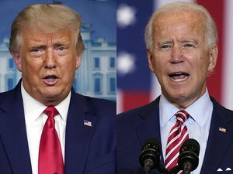
Prohibited Activities
Intervening in a political campaign of any candidate for public office (but you MAY encourage & register people to vote)
Engaging in partisan activity of any kind
Use of government funds to lobby including to lobby for government grants unless Congress expressly authorizes it (i.e., DDCs)

Slide 23
Registration & Reporting
State & federal lobby disclosure laws also require certain organizations & individuals who are paid to lobby or whose lobbying expenses are reimbursed to register & file periodic reports on lobbying activities

Slide 24
Threshold for Reporting
There is no minimum threshold for reporting on lobbying activities
Even though the dollar amount may be small, you should report it

Slide 25
How to report
IRS accepts any reasonable method for reporting
Sampling instead of complete time records to estimate time spent
Estimate of overhead costs
Actual costs when possible
Notes:
Sample lobbying expenditure form

Slide 26
Registration
Lobbying Disclosure Act of 1995
If you have any employee that spends at least 20% of time on federal lobbying activities & you spend $22,500 or more over 6 months on that lobbying activity, they must register as lobbyists & file reports

Slide 27
Sanctions
Non-electing
5% excise tax on excessive lobbying spending
Similar tax on managers who willfully & unreasonably agree to lobbying expenditures
Electing
25% excise tax on lobbying spending in excess of ceiling
Death sentence
Loss of exemption only if spending normally exceeds 150% of either overall or grassroots limit over 4 year period

Slide 28
Funding Lobbying
May not use any government funds to influence legislation
May not use foundation funds IF grant agreement letter prohibits it
May use funds generated by fee for service, contributions, membership dues, sale of materials, etc.

Slide 29
Other Options
Get a legislative body to invite you in writing to express your opinion (“technical advice”)
Set up 501(c) 4
No restrictions on the amount of lobbying
Gifts to a 501(c) 4 are not tax-deductible

Slide 30
State laws
Find information about additional limits or reporting requirements from your state association of nonprofit organizations
Find out more at www.bolderadvocacy.org/

Slide 31
Sample Policy
Prohibition against participating in electoral/partisan politics on behalf of the Parent Center
When speaking or writing with regard to legislation on behalf of Parent Center:
Employees and volunteers must identify themselves as representing Parent Center verbally and/or in writing;
All statements made when lobbying on behalf of Parent Center must be consistent with Parent Center’s position on the legislation and approved in advance by the ED
All approved lobbying activities and all expenditures related to lobbying activities must be reported to the ED on the Report of Lobbying Activities and Expenditures Form. The ED will report it to the Fiscal Office.

Slide 32
Sample Policy
When parent Center staff engage in lobbying, it is personal in nature & outside scope of their employment except when approved by the ED
Staff & volunteers must avoid the appearance that their personal lobbying activity is authorized by or on behalf of parent Center, & may only engage in such activity on their personal time
ED & Policy Director may engage in lobbying outside the scope of their employment with Parent Center; must not indicate their affiliation with Parent Center, must specify they are acting as an individual, engage in the activity on their own time, & may not be reimbursed in any manner by Parent Center

Slide 33
Sample by-laws language
Prohibited Activities: No substantial part of the activities of the corporation shall be the carrying on of propaganda, or otherwise attempting to influence legislation, although with Board approval certain informational materials may be distributed to its members and contacts. The corporation shall not participate in, or intervene in (including the publication or distribution of statements) any political campaign on behalf of, or in opposition to, any candidate for public office. Notwithstanding any other provision of these Articles, the corporation shall not carry on any other activities not permitted to be carried on (a) By a corporation exempt from Federal income tax under Section 501(c)(3) of the Internal Revenue Code (or corresponding section of any future Federal tax code) or (b) By a corporation, contributions to which are deductible under Section 170(c)(2) of the Internal Revenue Code, (or the corresponding provision of any future Federal tax code).

Slide 34
Take Away messages
You CAN & SHOULD engage in public policy advocacy & lobbying
For most non-profits, you SHOULD do the 501(h) election
You MUST report lobbying activities with your tax return regardless of whether you elect & no matter how little you spend on lobbying

Slide 35
Other resources
Alliance for Justice www.afj.org
Independent Sector www.independentsector.org
IRS
www.irs.gov/charities

Slide 36
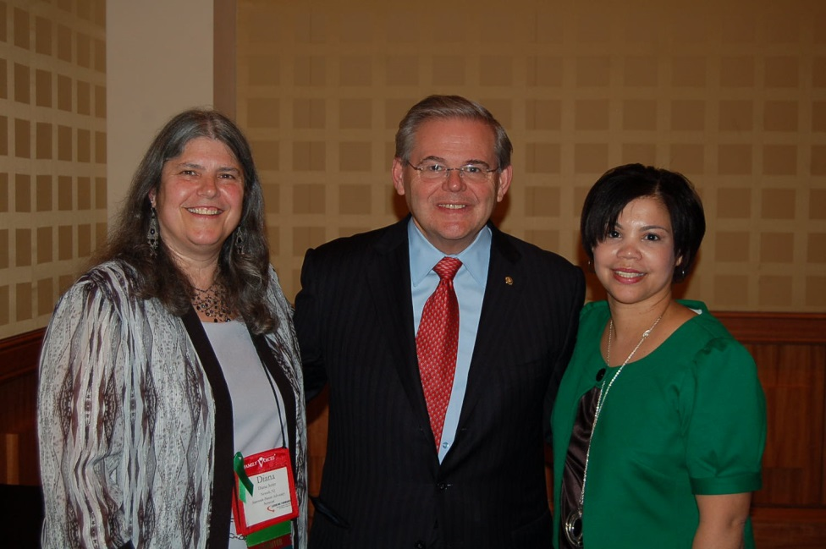
Don’t sit on the sidelines, get into the game!
Empowering family members to participate in advocacy for their children, their community, the larger society, is its own victory, regardless of the specific outcome of any particular effort.
Democracy is not a spectator sport!

Slide 37
